Slide 1
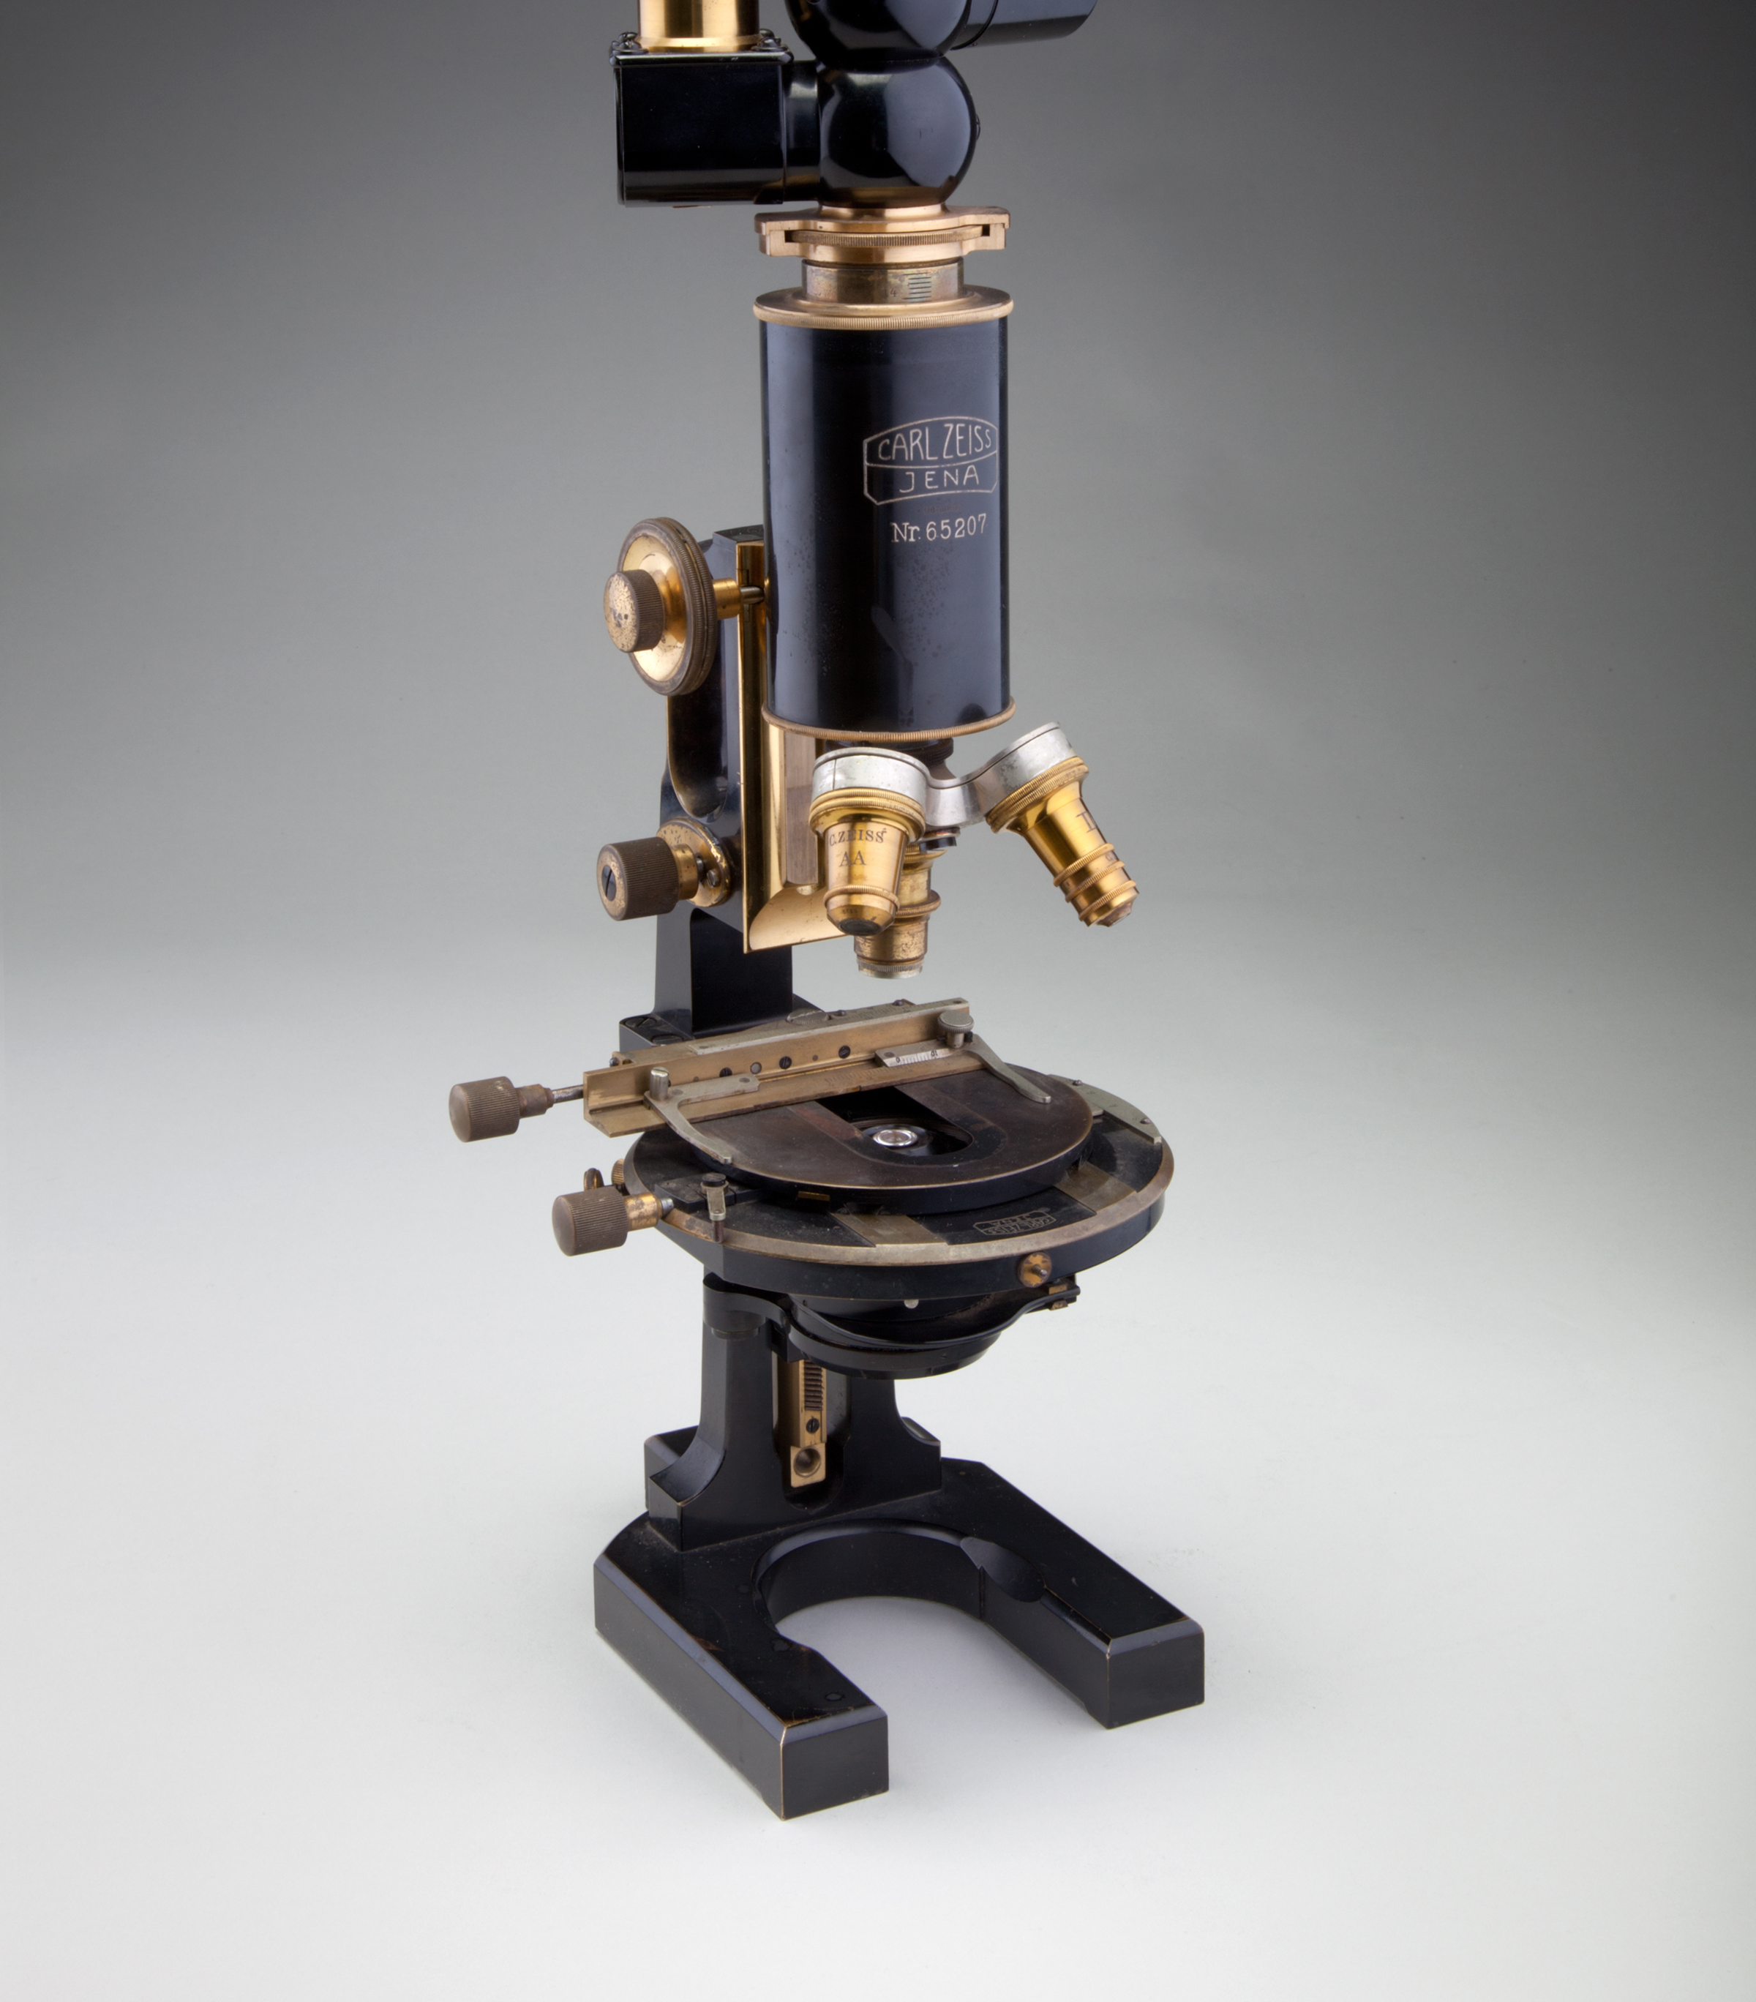

Deep Learning Microscopy
FruitPunch AI Code
11.06.2019
M. Alican Noyan

Slide 2
Paper

Slide 3
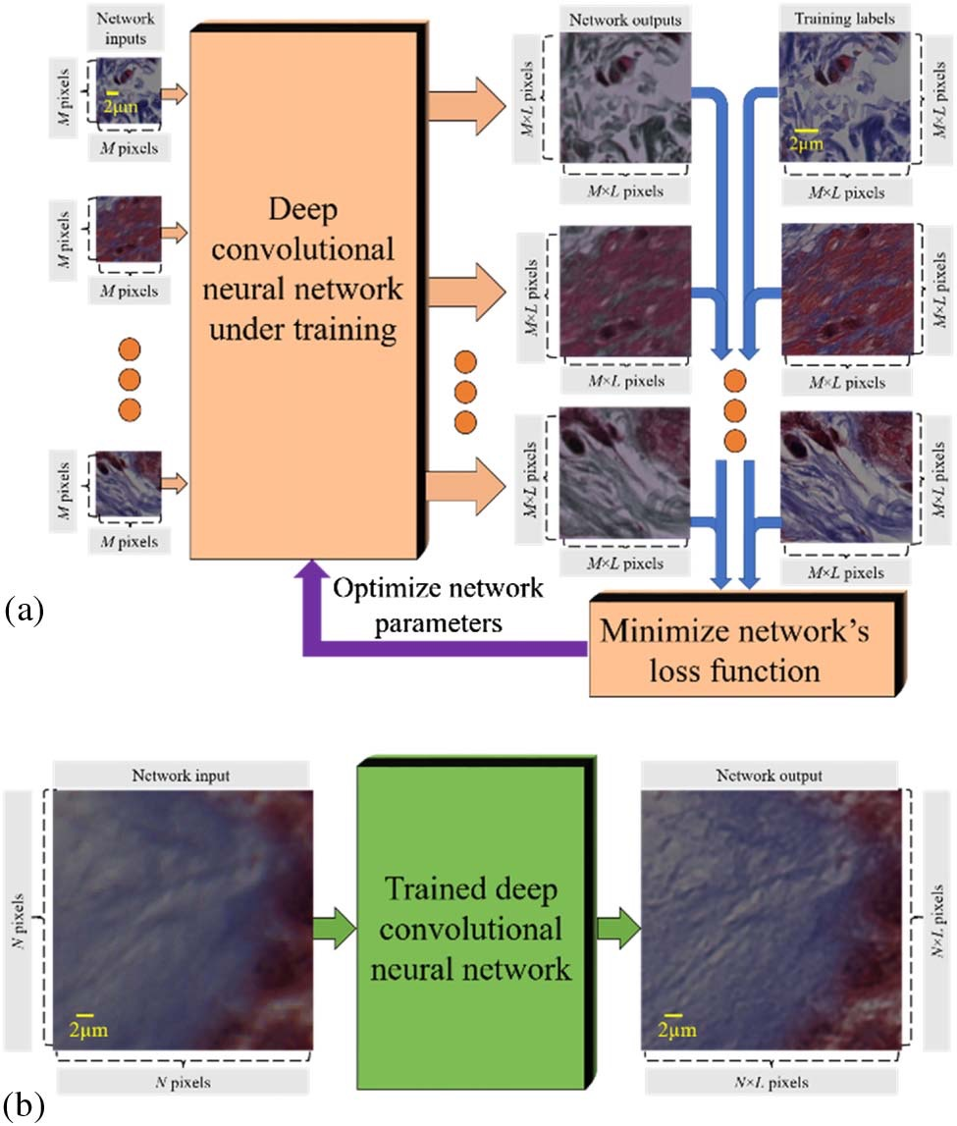
Paper

Slide 4
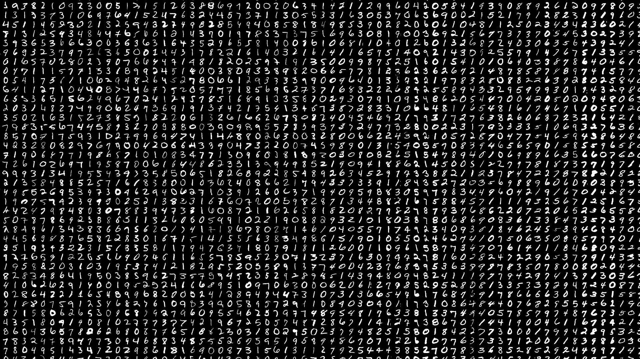
MNIST

Slide 5
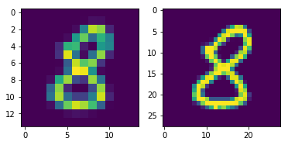
Challenge
Challenge:
Build such a NN
14 x 14
28 x 28
Image-to-image translation

